Slide 1
Klipper Defaults
Default I2C SDA=>P0.0, SCL=>P0.1
Default SPI SCK0=>P0.15, MISI0=>P0.17, MOSI0=>P0.18
Default USBD+=>P0.29, USBD-=>P0.30, USB connect=>P2.9
Default Serial RX=>P0.3, TX=>P0.2

Slide 2
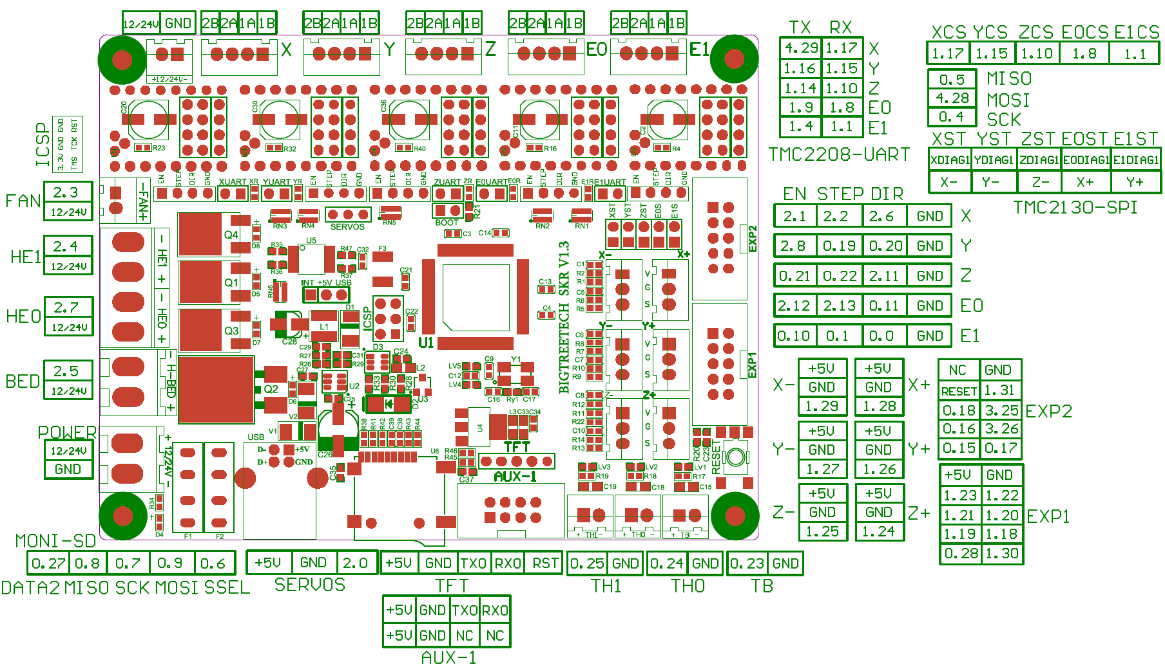

Slide 3
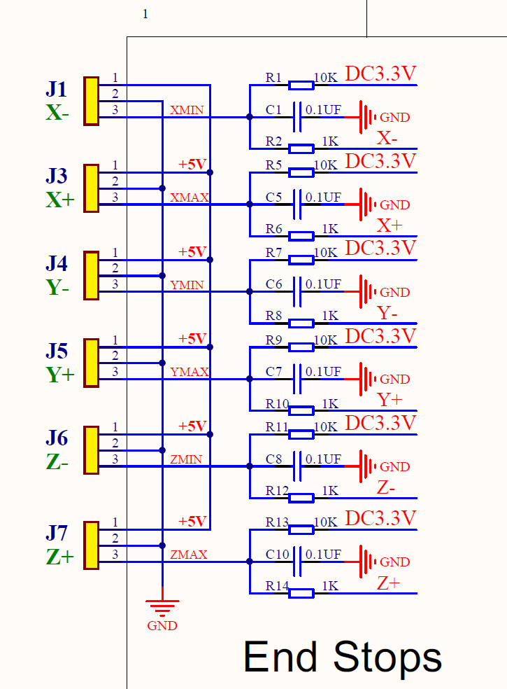

X+_STOP / E0_DIAG1 | P1.28 | I/O | P1[28] — General purpose digital input/output pin.
 |  | O | MCOA2 — Motor control PWM channel 2, output A.
 |  | I | PCAP1[0] — Capture input for PWM1, channel 0.
 |  | O | MAT0[0] — Match output for Timer 0, channel 0.
X-_STOP / X_DIAG1 | P1.29 | I/O | P1[29] — General purpose digital input/output pin.
 |  | O | MCOB2 — Motor control PWM channel 2, output B.
 |  | I | PCAP1[1] — Capture input for PWM1, channel 1.
 |  | O | MAT0[1] — Match output for Timer 0, channel 1.
Y+_STOP / E1_DIAG1 | P1.26 | I/O | P1[26] — General purpose digital input/output pin.
 |  | O | MCOB1 — Motor control PWM channel 1, output B.
 |  | O | PWM1[6] — Pulse Width Modulator 1, channel 6 output.
 |  | I | CAP0[0] — Capture input for Timer 0, channel 0.
Y-_STOP / Y_DIAG1 | P1.27 | I/O | P1[27] — General purpose digital input/output pin.
 |  | O | CLKOUT — Clock output pin.
 |  | I | USB_OVRCR — USB port Over-Current status. (LPC1769/68/66/65 only).
 |  | I | CAP0[1] — Capture input for Timer 0, channel 1.
Z+_STOP | P1.24 | I/O | P1[24] — General purpose digital input/output pin.
 |  | I | MCI2 — Motor control PWM channel 2, input. Also Quadrature Encoder Interface INDEX input.
 |  | O | PWM1[5] — Pulse Width Modulator 1, channel 5 output.
 |  | I/O | MOSI0 — Master Out Slave in for SSP0.
Z-_STOP / Z_DIAG1 | P1.25 | I/O | P1[25] — General purpose digital input/output pin.
 |  | O | MCOA1 — Motor control PWM channel 1, output A.
 |  | O | MAT1[1] — Match output for Timer 1, channel 1.

Slide 4
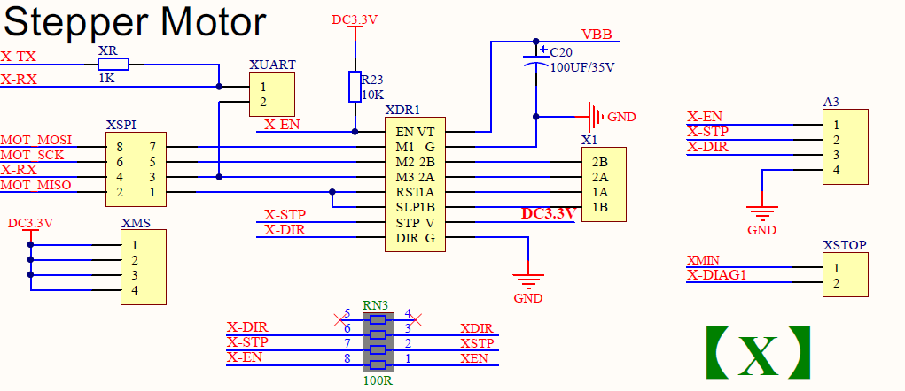
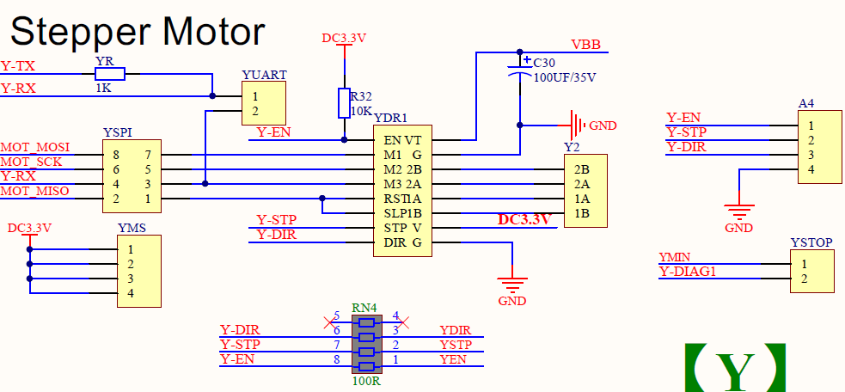
X_EN | 2.1 | I/O | P2[1] — General purpose digital input/output pin.
 |  | O | PWM1[2] — Pulse Width Modulator 1, channel 2 output.
 |  | I | RXD1 — Receiver input for UART1.
X_STEP | 2.2 | I/O | P2[2] — General purpose digital input/output pin.
 |  | O | PWM1[3] — Pulse Width Modulator 1, channel 3 output.
 |  | I | CTS1 — Clear to Send input for UART1.
 |  | O | TRACEDATA[3] — Trace data, bit 3.
X_DIR | 2.6 | I/O | P2[6] — General purpose digital input/output pin.
 |  | I | PCAP1[0] — Capture input for PWM1, channel 0.
 |  | I | RI1 — Ring Indicator input for UART1.
 |  | O | TRACECLK — Trace Clock.
Y_EN | 2.8 | I/O | P2[8] — General purpose digital input/output pin.
 |  | O | TD2 — CAN2 transmitter output. (LPC1769/68/66/65/64 only).
 |  | O | TXD2 — Transmitter output for UART2.
Y_STEP | 0.19 | I/O | P0[19] — General purpose digital input/output pin.
 |  | I | DSR1 — Data Set Ready input for UART1.
 |  | I/O | SDA1 — I2C1 data input/output (this is not an I2C-bus compliant open-drain pin).
Y_DIR | 0.20 | I/O | P0[20] — General purpose digital input/output pin.
 |  | O | DTR1 — Data Terminal Ready output for UART1. Can also be configured to be an RS-485/EIA-485 output enable signal.
 |  | I/O | SCL1 — I2C1 clock input/output (this is not an I2C-bus compliant open-drain pin).

Slide 5
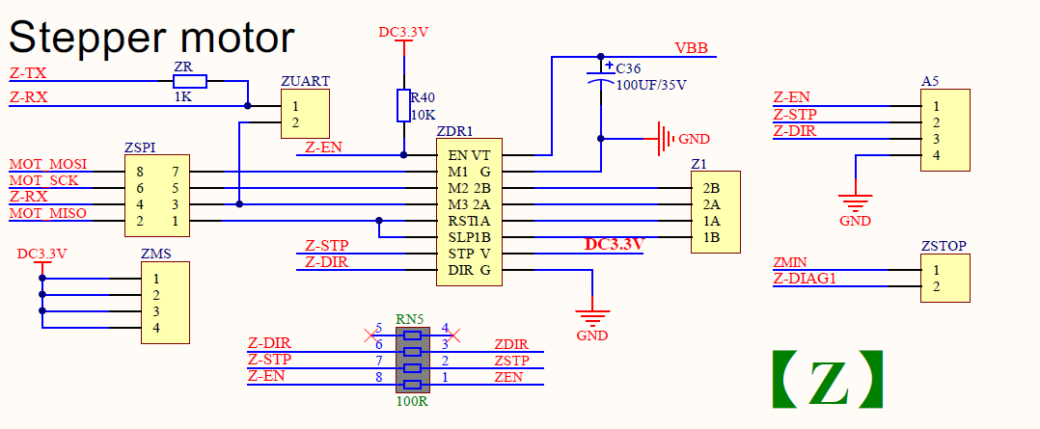
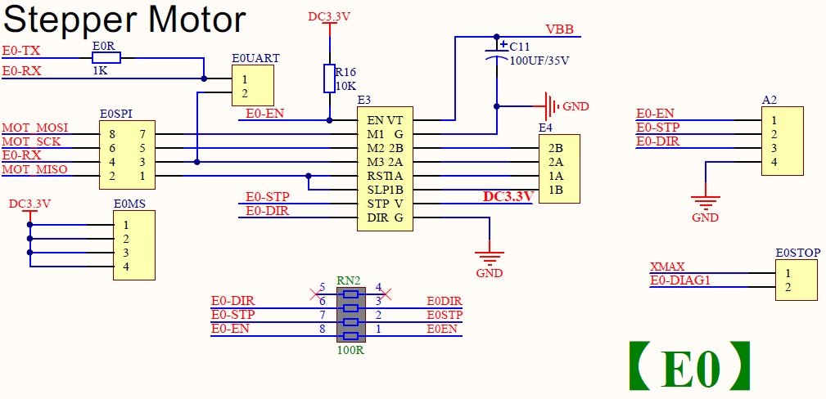
Z_EN | P0.21 | I/O | P0[21] — General purpose digital input/output pin.
 |  | I | RI1 — Ring Indicator input for UART1.
 |  | I | RD1 — CAN1 receiver input. (LPC1769/68/66/65/64 only).
Z_STEP | P0.22 | I/O | P0[22] — General purpose digital input/output pin.
 |  | O | RTS1 — Request to Send output for UART1. Can also be configured to be an RS-485/EIA-485 output enable signal.
 |  | O | TD1 — CAN1 transmitter output. (LPC1769/68/66/65/64 only).
Z_DIR | P2.11 | I/O | P2[11] — General purpose digital input/output pin.
 |  | I | EINT1 — External interrupt 1 input.
 |  | I/O | I2STX_CLK — Transmit Clock. It is driven by the master and received by the slave. Corresponds to the signal SCK in the I2S-bus specification. (LPC1769/68/67/66/65/63 only).
E0_EN | P2.12 | I/O | P2[12] — General purpose digital input/output pin.
 |  | I | EINT2 — External interrupt 2 input.
 |  | I/O | I2STX_WS — Transmit Word Select. It is driven by the master and received by the slave. Corresponds to the signal WS in the I2S-bus specification. (LPC1769/68/67/66/65/63 only).
E0_STEP | P2.13 | I/O | P2[13] — General purpose digital input/output pin.
 |  | I | EINT3 — External interrupt 3 input.
 |  | I/O | I2STX_SDA — Transmit data. It is driven by the transmitter and read by the receiver. Corresponds to the signal SD in the I2S-bus specification. (LPC1769/68/67/66/65/63 only).
E0_DIR | P0.11 | I/O | P0[11] — General purpose digital input/output pin.
 |  | I | RXD2 — Receiver input for UART2.
 |  | I/O | SCL2 — I2C2 clock input/output (this is not an open-drain pin).
 |  | O | MAT3[1] — Match output for Timer 3, channel 1.

Slide 6
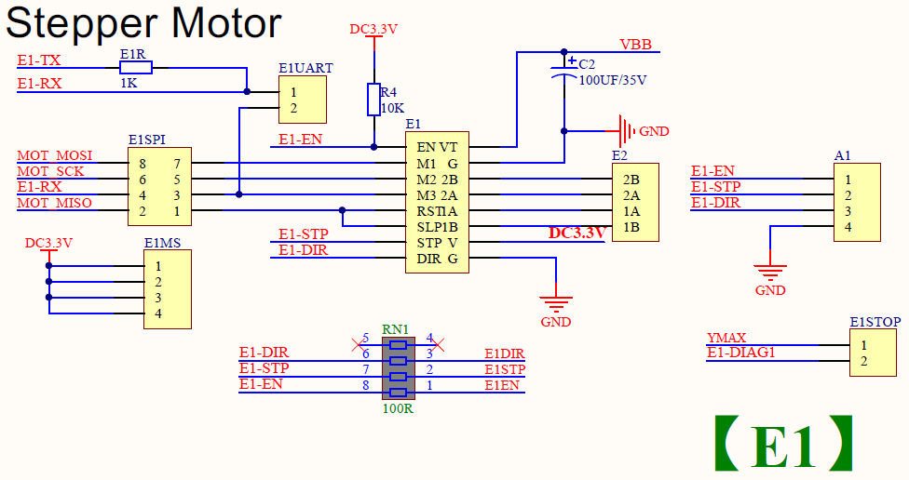
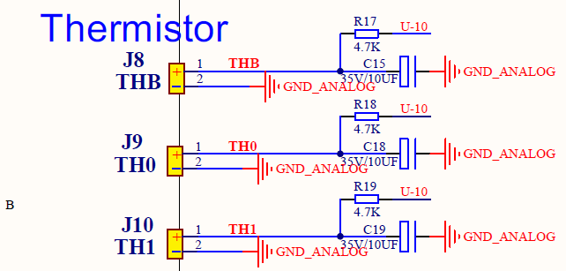
E1_EN | P0.10 | I/O | P0[10] — General purpose digital input/output pin.
 |  | O | TXD2 — Transmitter output for UART2.
 |  | I/O | SDA2 — I2C2 data input/output (this is not an open-drain pin).
 |  | O | MAT3[0] — Match output for Timer 3, channel 0.
E1_STEP | P0.1 | I/O | P0[1] — General purpose digital input/output pin.
 |  | O | TD1 — CAN1 transmitter output. (LPC1769/68/66/65/64 only).
 |  | I | RXD3 — Receiver input for UART3.
 |  | I/O | SCL1 — I2C1 clock input/output. (This is not an I2C-bus compliant open-drain pin).
E1_DIR | P0.0 | I/O | P0[0] — General purpose digital input/output pin.
 |  | I | RD1 — CAN1 receiver input. (LPC1769/68/66/65/64 only).
 |  | O | TXD3 — Transmitter output for UART3.
 |  | I/O | SDA1 — I2C1 data input/output. (This is not an I2C-bus compliant open-drain pin).
TH1 | P0.25 | I/O | P0[25] — General purpose digital input/output pin.
 |  | I | AD0[2] — A/D converter 0, input 2.
 |  | I/O | I2SRX_SDA — Receive data. It is driven by the transmitter and read by the receiver. Corresponds to the signal SD in the I2S-bus specification. (LPC1769/68/67/66/65/63 only).
 |  | O | TXD3 — Transmitter output for UART3.
TH0 | P0.24 | I/O | P0[24] — General purpose digital input/output pin.
 |  | I | AD0[1] — A/D converter 0, input 1.
 |  | I/O | I2SRX_WS — Receive Word Select. It is driven by the master and received by the slave. Corresponds to the signal WS in the I2S-bus specification. (LPC1769/68/67/66/65/63 only).
 |  | I | CAP3[1] — Capture input for Timer 3, channel 1.
TB | P0.23 | I/O | P0[23] — General purpose digital input/output pin.
 |  | I | AD0[0] — A/D converter 0, input 0.
 |  | I/O | I2SRX_CLK — Receive Clock. It is driven by the master and received by the slave. Corresponds to the signal SCK in the I2S-bus specification. (LPC1769/68/67/66/65/63 only).
 |  | I | CAP3[0] — Capture input for Timer 3, channel 0.

Slide 7
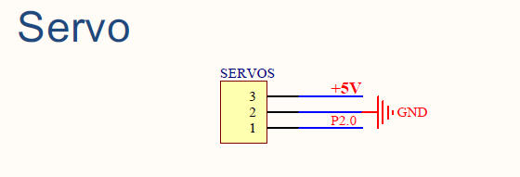
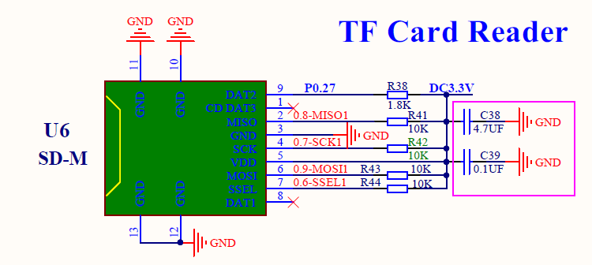
SERVO | P2.0 | I/O | P2[0] — General purpose digital input/output pin.
 |  | O | PWM1[1] — Pulse Width Modulator 1, channel 1 output.
 |  | O | TXD1 — Transmitter output for UART1.
SD_DET (NO_USE) | P0.27 | I/O | P0[27] — General purpose digital input/output pin. Output is open-drain. (open collector)
 |  | I/O | SDA0 — I2C0 data input/output. Open-drain output (for I2C-bus compliance).
 |  | I/O | USB_SDA — USB port I2C serial data (OTG transceiver, LPC1769/68/66/65 only).
SD_MISO | P0.8 | I/O | P0[8] — General purpose digital input/output pin.
 |  | I/O | I2STX_WS — Transmit Word Select. It is driven by the master and received by the slave. Corresponds to the signal WS in the I2S-bus specification. (LPC1769/68/67/66/65/63 only).
 |  | I/O | MISO1 — Master In Slave Out for SSP1.
 |  | O | MAT2[2] — Match output for Timer 2, channel 2.
SD_SCK | P0.7 | I/O | P0[7] — General purpose digital input/output pin.
 |  | I/O | I2STX_CLK — Transmit Clock. It is driven by the master and received by the slave. Corresponds to the signal SCK in the I2S-bus specification. (LPC1769/68/67/66/65/63 only).
 |  | I/O | SCK1 — Serial Clock for SSP1.
 |  | O | MAT2[1] — Match output for Timer 2, channel 1.
SD_MOSI | P0.9 | I/O | P0[9] — General purpose digital input/output pin.
 |  | I/O | I2STX_SDA — Transmit data. It is driven by the transmitter and read by the receiver. Corresponds to the signal SD in the I2S-bus specification. (LPC1769/68/67/66/65/63 only).
 |  | I/O | MOSI1 — Master Out Slave In for SSP1.
 |  | O | MAT2[3] — Match output for Timer 2, channel 3.
SD_SSEL (ONBOARD_SD_CS) | P0.6 | I/O | P0[6] — General purpose digital input/output pin.
 |  | I/O | I2SRX_SDA — Receive data. It is driven by the transmitter and read by the receiver. Corresponds to the signal SD in the I2S-bus specification. (LPC1769/68/67/66/65/63 only).
 |  | I/O | SSEL1 — Slave Select for SSP1.
 |  | O | MAT2[0] — Match output for Timer 2, channel 0.

Slide 8
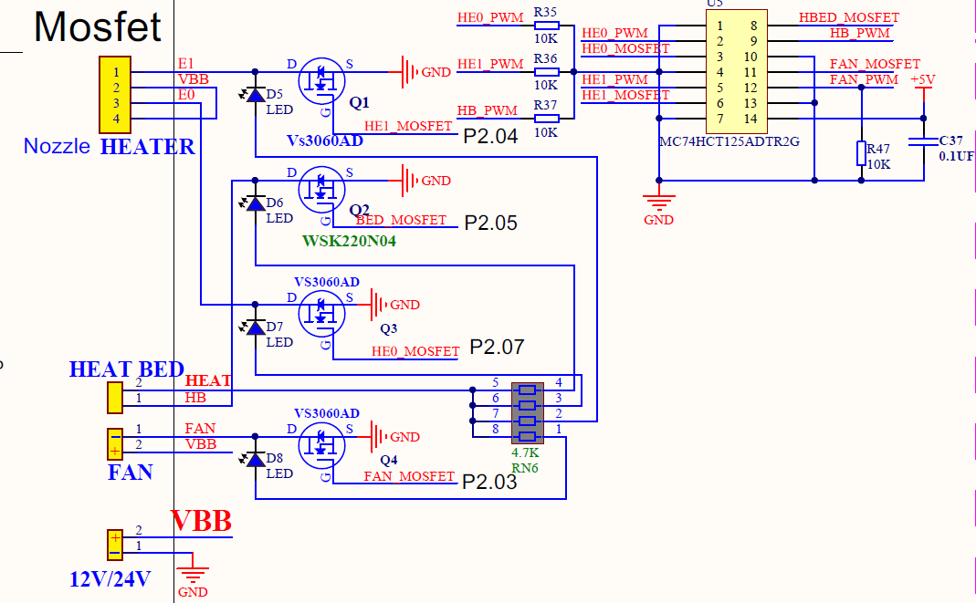
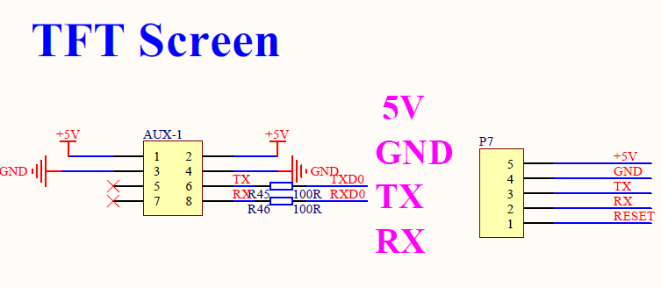
FAN | P2.3 | I/O | P2[3] — General purpose digital input/output pin.
 |  | O | PWM1[4] — Pulse Width Modulator 1, channel 4 output.
 |  | I | DCD1 — Data Carrier Detect input for UART1.
 |  | O | TRACEDATA[2] — Trace data, bit 2.
HE1 | P2.4 | I/O | P2[4] — General purpose digital input/output pin.
 |  | O | PWM1[5] — Pulse Width Modulator 1, channel 5 output.
 |  | I | DSR1 — Data Set Ready input for UART1.
 |  | O | TRACEDATA[1] — Trace data, bit 1.
HE0 | P2.7 | I/O | P2[7] — General purpose digital input/output pin.
 |  | I | RD2 — CAN2 receiver input. (LPC1769/68/66/65/64 only).
 |  | O | RTS1 — Request to Send output for UART1. Can also be configured to be an RS-485/EIA-485 output enable signal.
BED | P2.5 | I/O | P2[5] — General purpose digital input/output pin.
 |  | O | PWM1[6] — Pulse Width Modulator 1, channel 6 output.
 |  | O | DTR1 — Data Terminal Ready output for UART1. Can also be configured to be an RS-485/EIA-485 output enable signal.
 |  | O | TRACEDATA[0] — Trace data, bit 0.
TX0 | P0.2 | I/O | P0[2] — General purpose digital input/output pin.
 |  | O | TXD0 — Transmitter output for UART0.
 |  | I | AD0[7] — A/D converter 0, input 7.
RX0 | P0.3 | I/O | P0[3] — General purpose digital input/output pin.
 |  | I | RXD0 — Receiver input for UART0.
 |  | I | AD0[6] — A/D converter 0, input 6.

Slide 9
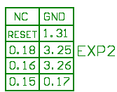
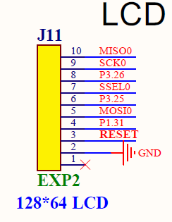
RESET
SD_MOSI (MOSI_PIN) | P0.18 | I/O | P0[18] — General purpose digital input/output pin.
 |  | I | DCD1 — Data Carrier Detect input for UART1.
 |  | I/O | MOSI0 — Master Out Slave In for SSP0.
 |  | I/O | MOSI — Master Out Slave In for SPI.
SD_CSEL (LCD_SDSS , SS_PIN) | P0.16 | I/O | P0[16] — General purpose digital input/output pin.
 |  | I | RXD1 — Receiver input for UART1.
 |  | I/O | SSEL0 — Slave Select for SSP0.
 |  | I/O | SSEL — Slave Select for SPI.
SD_SCK (SCK_PIN) | P0.15 | I/O | P0[15] — General purpose digital input/output pin.
 |  | O | TXD1 — Transmitter output for UART1.
 |  | I/O | SCK0 — Serial clock for SSP0.
 |  | I/O | SCK — Serial clock for SPI.
SD_DET | P1.31 | I/O | P1[31] — General purpose digital input/output pin. (not 5V tolerant)
 |  | I/O | SCK1 — Serial Clock for SSP1.
 |  | I | AD0[5] — A/D converter 0, input 5.
BTN_EN2 | P3.25 | I/O | P3[25] — General purpose digital input/output pin.
 |  | O | MAT0[0] — Match output for Timer 0, channel 0.
 |  | O | PWM1[2] — Pulse Width Modulator 1, output 2.

Slide 10
BTN_EN1 | P3.26 | I/O | P3[26] — General purpose digital input/output pin.
 |  | I | STCLK — System tick timer clock input. The maximum STCLK frequency is 1/4 of the Arm processor clock frequency CCLK.
 |  | O | MAT0[1] — Match output for Timer 0, channel 1.
 |  | O | PWM1[3] — Pulse Width Modulator 1, output 3.
SD_MISO (MISO_PIN) | P0.17 | I/O | P0[17] — General purpose digital input/output pin.
 |  | I | CTS1 — Clear to Send input for UART1.
 |  | I/O | MISO0 — Master In Slave Out for SSP0.
 |  | I/O | MISO — Master In Slave Out for SPI.

Slide 11
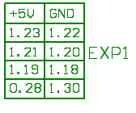
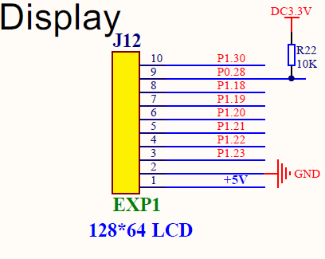
LCD7 / NO-USE / D_MOSI (LCD_ENABLE) | P1.23 | I/O | P1[23] — General purpose digital input/output pin.
 |  | I | MCI1 — Motor control PWM channel 1, input. Also Quadrature Encoder Interface PHB input.
 |  | O | PWM1[4] — Pulse Width Modulator 1, channel 4 output.
 |  | I/O | MISO0 — Master In Slave Out for SSP0.
LCD5 / NO-USE / D_SCK (LCD_D4) | P1.21 | I/O | P1[21] — General purpose digital input/output pin.
 |  | O | MCABORT — Motor control PWM, LOW-active fast abort.
 |  | O | PWM1[3] — Pulse Width Modulator 1, channel 3 output.
 |  | I/O | SSEL0 — Slave Select for SSP0.
LCDRS / D_CS (LCD_RS) / RESET | P1.19 | I/O | P1[19] — General purpose digital input/output pin.
 |  | O | MCOA0 — Motor control PWM channel 0, output A.
 |  | O | USB_PPWR — Port Power enable signal for USB port. (LPC1769/68/66/65 only).
 |  | I | CAP1[1] — Capture input for Timer 1, channel 1.
BTN_ENC / BTN_CLICK (BTN_ENC) / BTN_CLICK (BTN_ENC) | P0.28 | I/O | P0[28] — General purpose digital input/output pin. Output is open-drain. (open collector)
 |  | I/O | SCL0 — I2C0 clock input/output. Open-drain output (for I2C-bus compliance).
 |  | I/O | USB_SCL — USB port I2C serial clock (OTG transceiver, LPC1769/68/66/65 only).
LCD6 / NO_USE / D_CS (LCD_RS) | P1.22 | I/O | P1[22] — General purpose digital input/output pin.
 |  | O | MCOB0 — Motor control PWM channel 0, output B.
 |  | I | USB_PWRD — Power Status for USB port (host power switch, LPC1769/68/66/65 only).
 |  | O | MAT1[0] — Match output for Timer 1, channel 0.
LCD4 / D_SCK (LCD_D4) / BTN_EN2 | P1.20 | I/O | P1[20] — General purpose digital input/output pin.
 |  | I | MCI0 — Motor control PWM channel 0, input. Also Quadrature Encoder Interface PHA input.
 |  | O | PWM1[2] — Pulse Width Modulator 1, channel 2 output.
 |  | I/O | SCK0 — Serial clock for SSP0.
EXP1 / EXP1 Serial Display / EXP3 Serial Display No SD Card Support
EXP1 supports Creality stock display without SD card reader and single cable on EXP3
CR-10 / Ender 3 Stock Display

Slide 12
LCDE / D_MOSI (LCD_ENABLE) / BTN_EN1 | P1.18 | I/O | P1[18] — General purpose digital input/output pin.
 |  | O | USB_UP_LED — USB GoodLink LED indicator. It is LOW when the device is configured (non-control endpoints enabled), or when the host is enabled and has detected a device on the bus. It is HIGH when the device is not configured, or when host is enabled and has not detected a device on the bus, or during global suspend. It transitions between LOW and HIGH (flashes) when the host is enabled and detects activity on the bus. (LPC1769/68/66/65/64 only).
 |  | O | PWM1[1] — Pulse Width Modulator 1, channel 1 output.
 |  | I | CAP1[0] — Capture input for Timer 1, channel 0.
BEEPER / BEEPER / BEEPER | P1.30 | I/O | P1[30] — General purpose digital input/output pin. (not 5V tolerant)
 |  | I | VBUS — Monitors the presence of USB bus power. (LPC1769/68/66/65/64 only). Note: This signal must be HIGH for USB reset to occur.
 |  | I | AD0[4] — A/D converter 0, input 4.
CR-10 / Ender 3 Stock Display

Slide 13
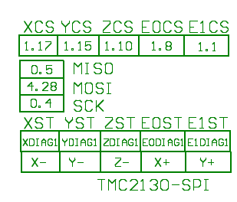
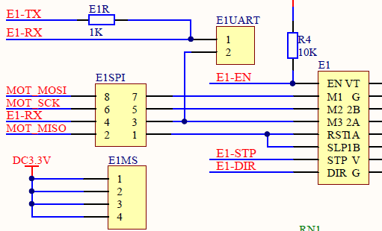
M_MISO | 0.5 | I/O | P0[5] — General purpose digital input/output pin.
 |  | I/O | I2SRX_WS — Receive Word Select. It is driven by the master and received by the slave. Corresponds to the signal WS in the I2S-bus specification. (LPC1769/68/67/66/65/63 only).
 |  | O | TD2 — CAN2 transmitter output. (LPC1769/68/66/65/64 only).
 |  | I | CAP2[1] — Capture input for Timer 2, channel 1.
M_MOSI | 4.28 | I/O | P4[28] — General purpose digital input/output pin.
 |  | O | RX_MCLK — I2S receive master clock. (LPC1769/68/67/66/65 only).
 |  | O | MAT2[0] — Match output for Timer 2, channel 0.
 |  | O | TXD3 — Transmitter output for UART3.
M_SCK | P0.4 | I/O | P0[4] — General purpose digital input/output pin.
 |  | I/O | I2SRX_CLK — Receive Clock. It is driven by the master and received by the slave. Corresponds to the signal SCK in the I2S-bus specification. (LPC1769/68/67/66/65/63 only).
 |  | I | RD2 — CAN2 receiver input. (LPC1769/68/66/65/64 only).
 |  | I | CAP2[0] — Capture input for Timer 2, channel 0.
M_X_CS | P1.17 | I/O | P1[17] — General purpose digital input/output pin.
 |  | I/O | ENET_MDIO — Ethernet MIIM data input and output. (LPC1769/68/67/66/64 only).
M_Y_CS | P1.15 | I/O | P1[15] — General purpose digital input/output pin.
 |  | I | ENET_REF_CLK — Ethernet reference clock. (LPC1769/68/67/66/64 only).
M_Z_CS | P1.10 | I/O | P1[10] — General purpose digital input/output pin.
 |  | I | ENET_RXD1 — Ethernet receive data. (LPC1769/68/67/66/64 only).

Slide 14
M_E0_CS | P1.8 | I/O | P1[8] — General purpose digital input/output pin.
 |  | I | ENET_CRS — Ethernet carrier sense. (LPC1769/68/67/66/64 only).
M_E1_CS | P1.1 | I/O | P1[1] — General purpose digital input/output pin.
 |  | O | ENET_TXD1 — Ethernet transmit data 1. (LPC1769/68/67/66/64 only).

Slide 15
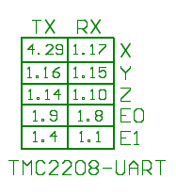
X_TX | P4.29 | I/O | P4[29] — General purpose digital input/output pin.
 |  | O | TX_MCLK — I2S transmit master clock. (LPC1769/68/67/66/65 only).
 |  | O | MAT2[1] — Match output for Timer 2, channel 1.
 |  | I | RXD3 — Receiver input for UART3.
X_RX | P1.17 | I/O | P1[17] — General purpose digital input/output pin.
 |  | I/O | ENET_MDIO — Ethernet MIIM data input and output. (LPC1769/68/67/66/64 only).
Y_TX | P1.16 | I/O | P1[16] — General purpose digital input/output pin.
 |  | O | ENET_MDC — Ethernet MIIM clock (LPC1769/68/67/66/64 only).
Y_RX | P1.15 | I/O | P1[15] — General purpose digital input/output pin.
 |  | I | ENET_REF_CLK — Ethernet reference clock. (LPC1769/68/67/66/64 only).
Z_TX | P1.14 | I/O | P1[14] — General purpose digital input/output pin.
 |  | I | ENET_RX_ER — Ethernet receive error. (LPC1769/68/67/66/64 only).
Z_RX | P1.10 |  | P1[10] — General purpose digital input/output pin.
 |  |  | ENET_RXD1 — Ethernet receive data. (LPC1769/68/67/66/64 only).

Slide 16
E0_TX | P1.9 | I/O | P1[9] — General purpose digital input/output pin.
 |  | I | ENET_RXD0 — Ethernet receive data. (LPC1769/68/67/66/64 only).
E0_RX | P1.8 | I/O | P1[8] — General purpose digital input/output pin.
 |  | I | ENET_CRS — Ethernet carrier sense. (LPC1769/68/67/66/64 only).
E1_TX | P1.4 | I/O | P1[4] — General purpose digital input/output pin.
 |  | O | ENET_TX_EN — Ethernet transmit data enable. (LPC1769/68/67/66/64 only).
E1_RX | P1.1 | I/O | P1[1] — General purpose digital input/output pin.
 |  | O | ENET_TXD1 — Ethernet transmit data 1. (LPC1769/68/67/66/64 only).

